Slide 1
Fundamentals of Nursing Department
College of Nursing
University of Basra
First Stage
Lecture 5: (Theory)
Wound Care and Healing Process
University of Basra –College of Nursing – Fundamentals of Nursing Department

Slide 2
Objectives
To the definition of the skin and anatomy
To definition wounds and classification wounds
To explain emergency care for each type of wounds
To learning of the process of wound healing

Slide 3
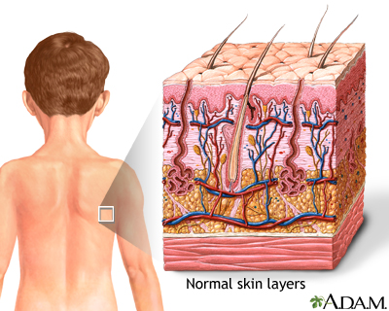
Skin: Is the largest organ of the body, with a total area of about 20 square feet.

Slide 5
Skin

Slide 6
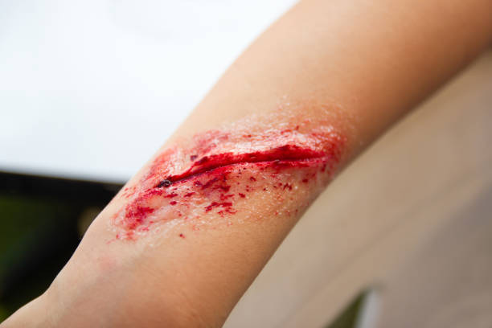
Wounds
A wound: is a break in the continuity of a tissue of the body, either internal or external.

Slide 7
Classification of Wounds
1- Open wound is a break in the skin or in a mucous membrane.
2- Closed wound involves underlying tissues without a break in the skin or a mucous membrane.

Slide 8
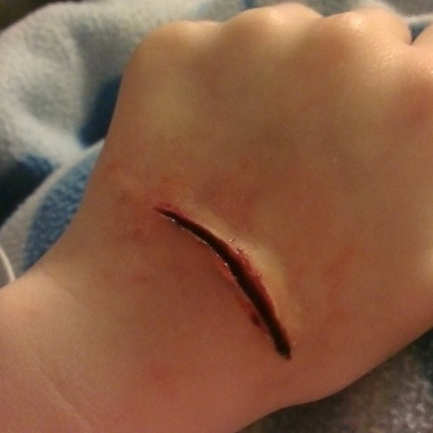
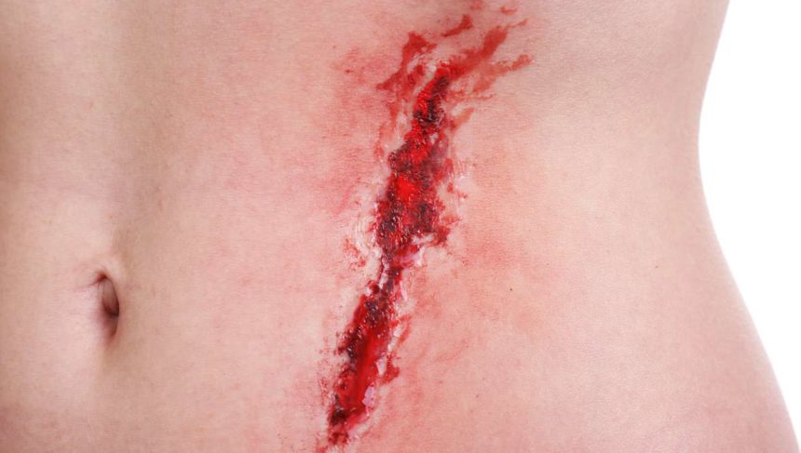
Classification of Wounds
1- Open wound

Slide 9
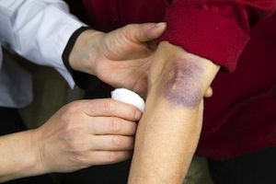
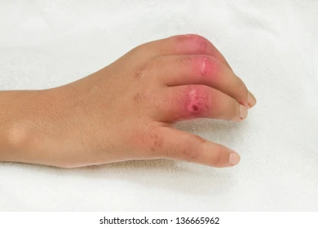
Classification of Wounds
2- Closed wound

Slide 10
Causes of wounds
1-Motor vehicle accidents.
2- Falls.
3- Mishandling of sharp objects, tools, machinery, and weapons.

Slide 11
Types of open Wounds
Abrasions: An abrasion results from scraping the skin and damaging it.
Bleeding: is limited to oozing of blood from ruptured small veins and capillaries.
Danger: contamination and infection.
Cause: It is result from falls or the handling of rough objects.
Examples are skinned knees, rope burns.

Slide 12
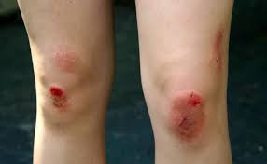
Types of open Wounds
Abrasions

Slide 13
Types of open Wounds
2. Incisions: Incised wounds, or cuts in body tissues.
Bleeding: depends on the depth and extent of a cut. Deep cuts may involve blood vessels and may cause extensive bleeding. They may also damage muscles, tendons, and nerves.
Cause: by knives, metal edges, broken glass, or other sharp objects.

Slide 14
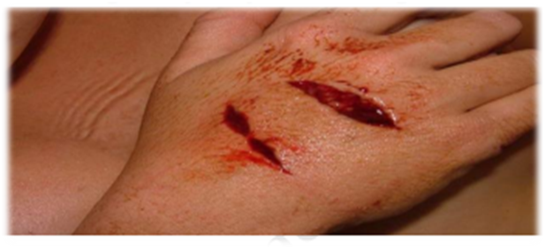
Types of open Wounds
2. Incisions:

Slide 15
Types of open Wounds
3. Lacerations: are jagged, irregular, or tears in the soft tissues.
Bleeding: may be rapid and extensive.
The deep contamination of wounds that result from accidents involving moving parts of machinery increases the chances of infection.

Slide 16
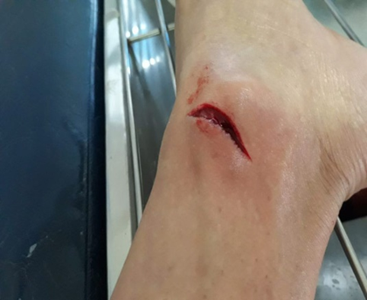
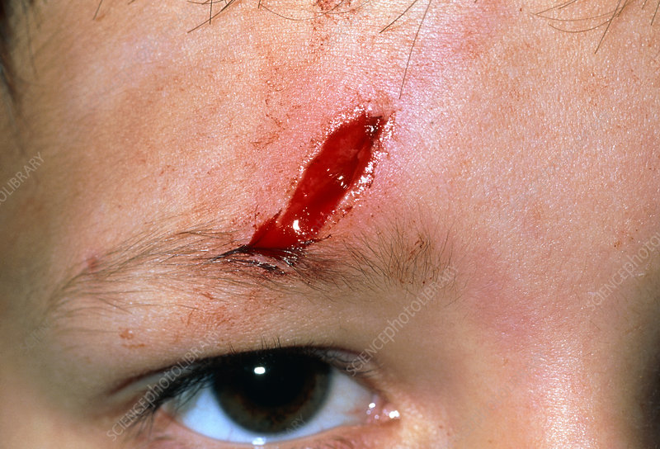
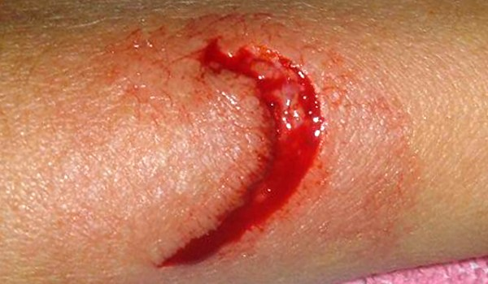
Types of open Wounds
3.Lacerations:

Slide 17
Types of open Wounds
4.Punctures: Puncture wounds are produced by bullets and pointed objects, such as pins, nails, and splinters.
Bleeding: External bleeding is usually minor, but the puncturing object may penetrate deeply into the body and thus damage organs and cause severe internal bleeding.

Slide 18
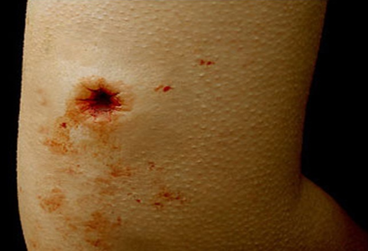
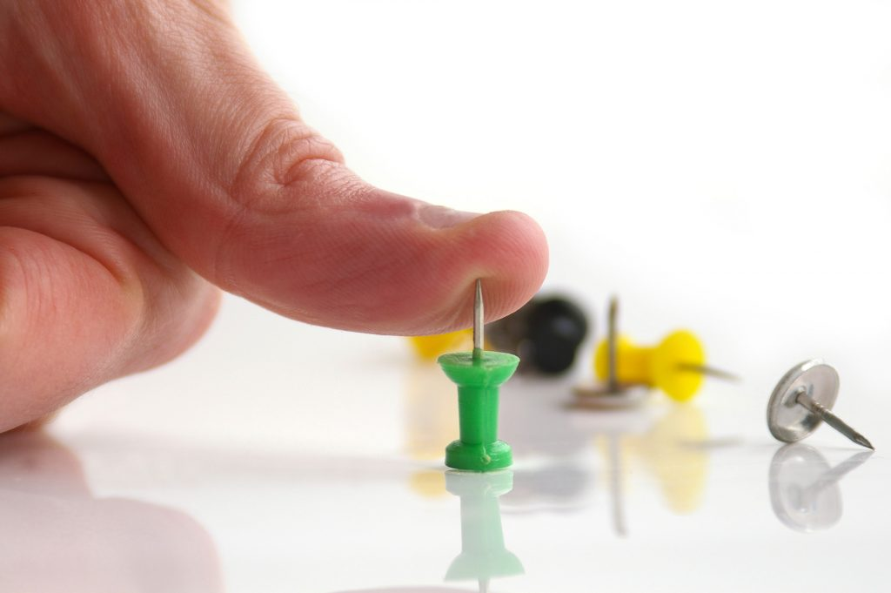
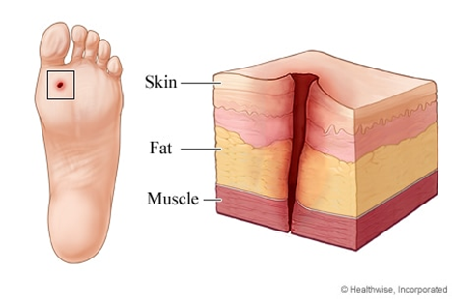
Types of open Wounds
4.Punctures:

Slide 19
Types of open Wounds
5. Avulsions: Avulsion wounds involve the forcible separation or tearing of tissue from the victim's body.
Cause: animal bites and accidents involving motor vehicles, heavy machinery, guns, and explosives

Slide 20
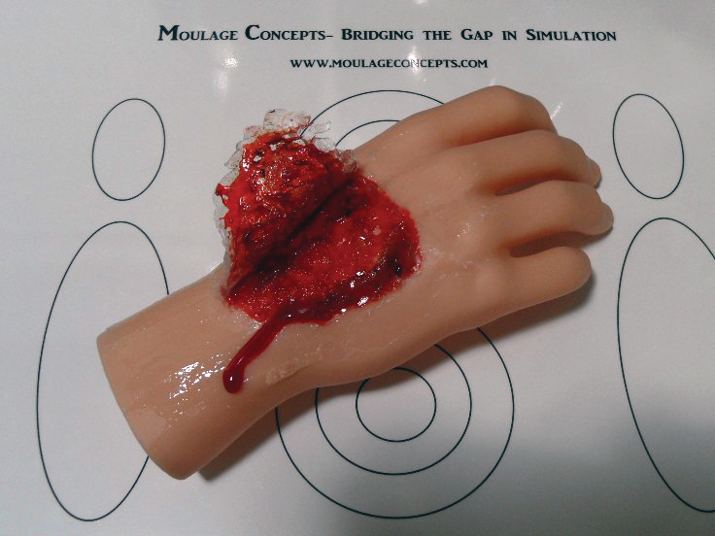
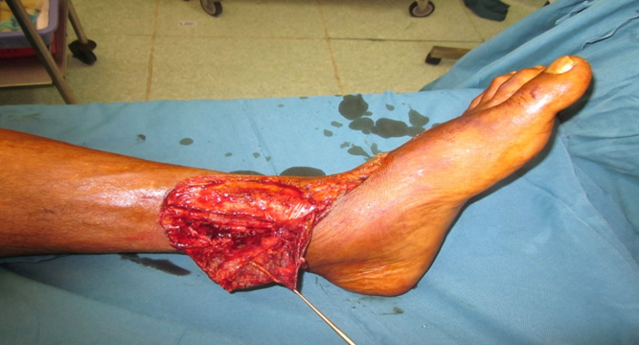
Types of open Wounds
5.Avulsions :

Slide 21
Open wound
If the wound is not deep and gapes slightly it need only hold the wound edges together, dress, and bandage the injury.
Below are a number of open-wound conditions that require medical treatment after emergency care:
Blood spurting from a wound, even if controlled initially by first aid.
An incised wound deeper than the outer layer of skin.
Any laceration, deep puncture, or avulsion.
Severed or crushed nerve, tendon, or muscle.

Slide 22
5. Laceration of the face or other parts of the body.
6. Skin broken by a bite, human or animal.
7. Heavy contamination of a wound by soil or organic materials.
8. Foreign matter in a wound, not possible to remove by washing.

Slide 23
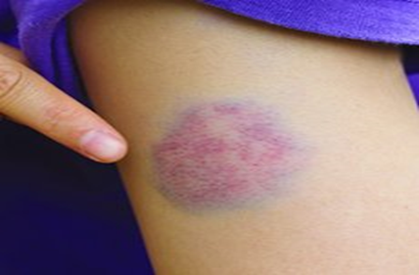
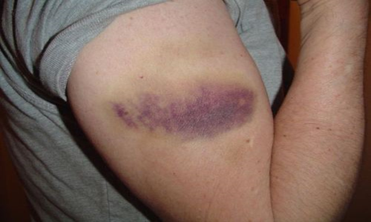
Closed Wounds
External forces, such as falls and motor vehicle accidents, cause most closed wounds.
Many closed wounds are relatively small and involve soft tissues

Slide 24
Signs and Symptoms
Internal injury is probable when any of the following general symptoms are present:
1. Cold, clammy, pale skin, very rapid but weak pulse, rapid breathing, and dizziness.
2. Pain and tenderness in a part of the body.
3. Uncontrolled restlessness and excessive thirst.
4. Vomiting or coughing up of blood or passage of blood in the urine or feces.

Slide 25
Emergency Care
1. Carefully examine the victim for fractures and other injuries to the head, neck, chest, abdomen, limbs, back, and spine.
2. If an internal injury is suspected, get medical care for the victim as soon as possible.
3. If a closed fracture is suspected; immobilize the affected area before moving the victim.

Slide 26
Emergency Care
4. Carefully transport him in a lying position and give special attention to preventing shock.
5. watch the victim's breathing and take measures to prevent either blockage of the airway or stoppage of breathing.
6. Do not give fluids by mouth to a victim suspected of having internal injury.
7. When a relatively small closed wound occurs (such as a black eye), put cold applications on the injured area.

Slide 27
Wounds Contamination (infection)
The period of healing after an injury may be greatly prolonged by infection.
Careful cleansing of an open wound removes particles of dead tissue and foreign matter and reduces the number of bacteria, helping to prevent infection.

Slide 28
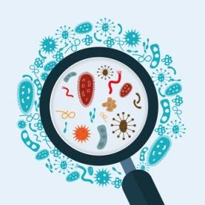
Symptoms of infected wounds:
Swelling of the affected part.
Redness of the affected part.
A sensation of heat.
Throbbing pain.
Tenderness.
Fever
Pus

Slide 29
Symptoms of infected wounds:
8. Swollen lymph glands in the groin (leg infection), in the armpit (arm infection), or in the neck (infection of the head).
9. Red streaks leading from the wound—an indication that the infection is spreading through the lymphatic circulation channels.

Slide 30
Nursing Diagnosis
Risk for Infection
Impaired Skin ( tissue) Integrity
Deficient Knowledge

Slide 31
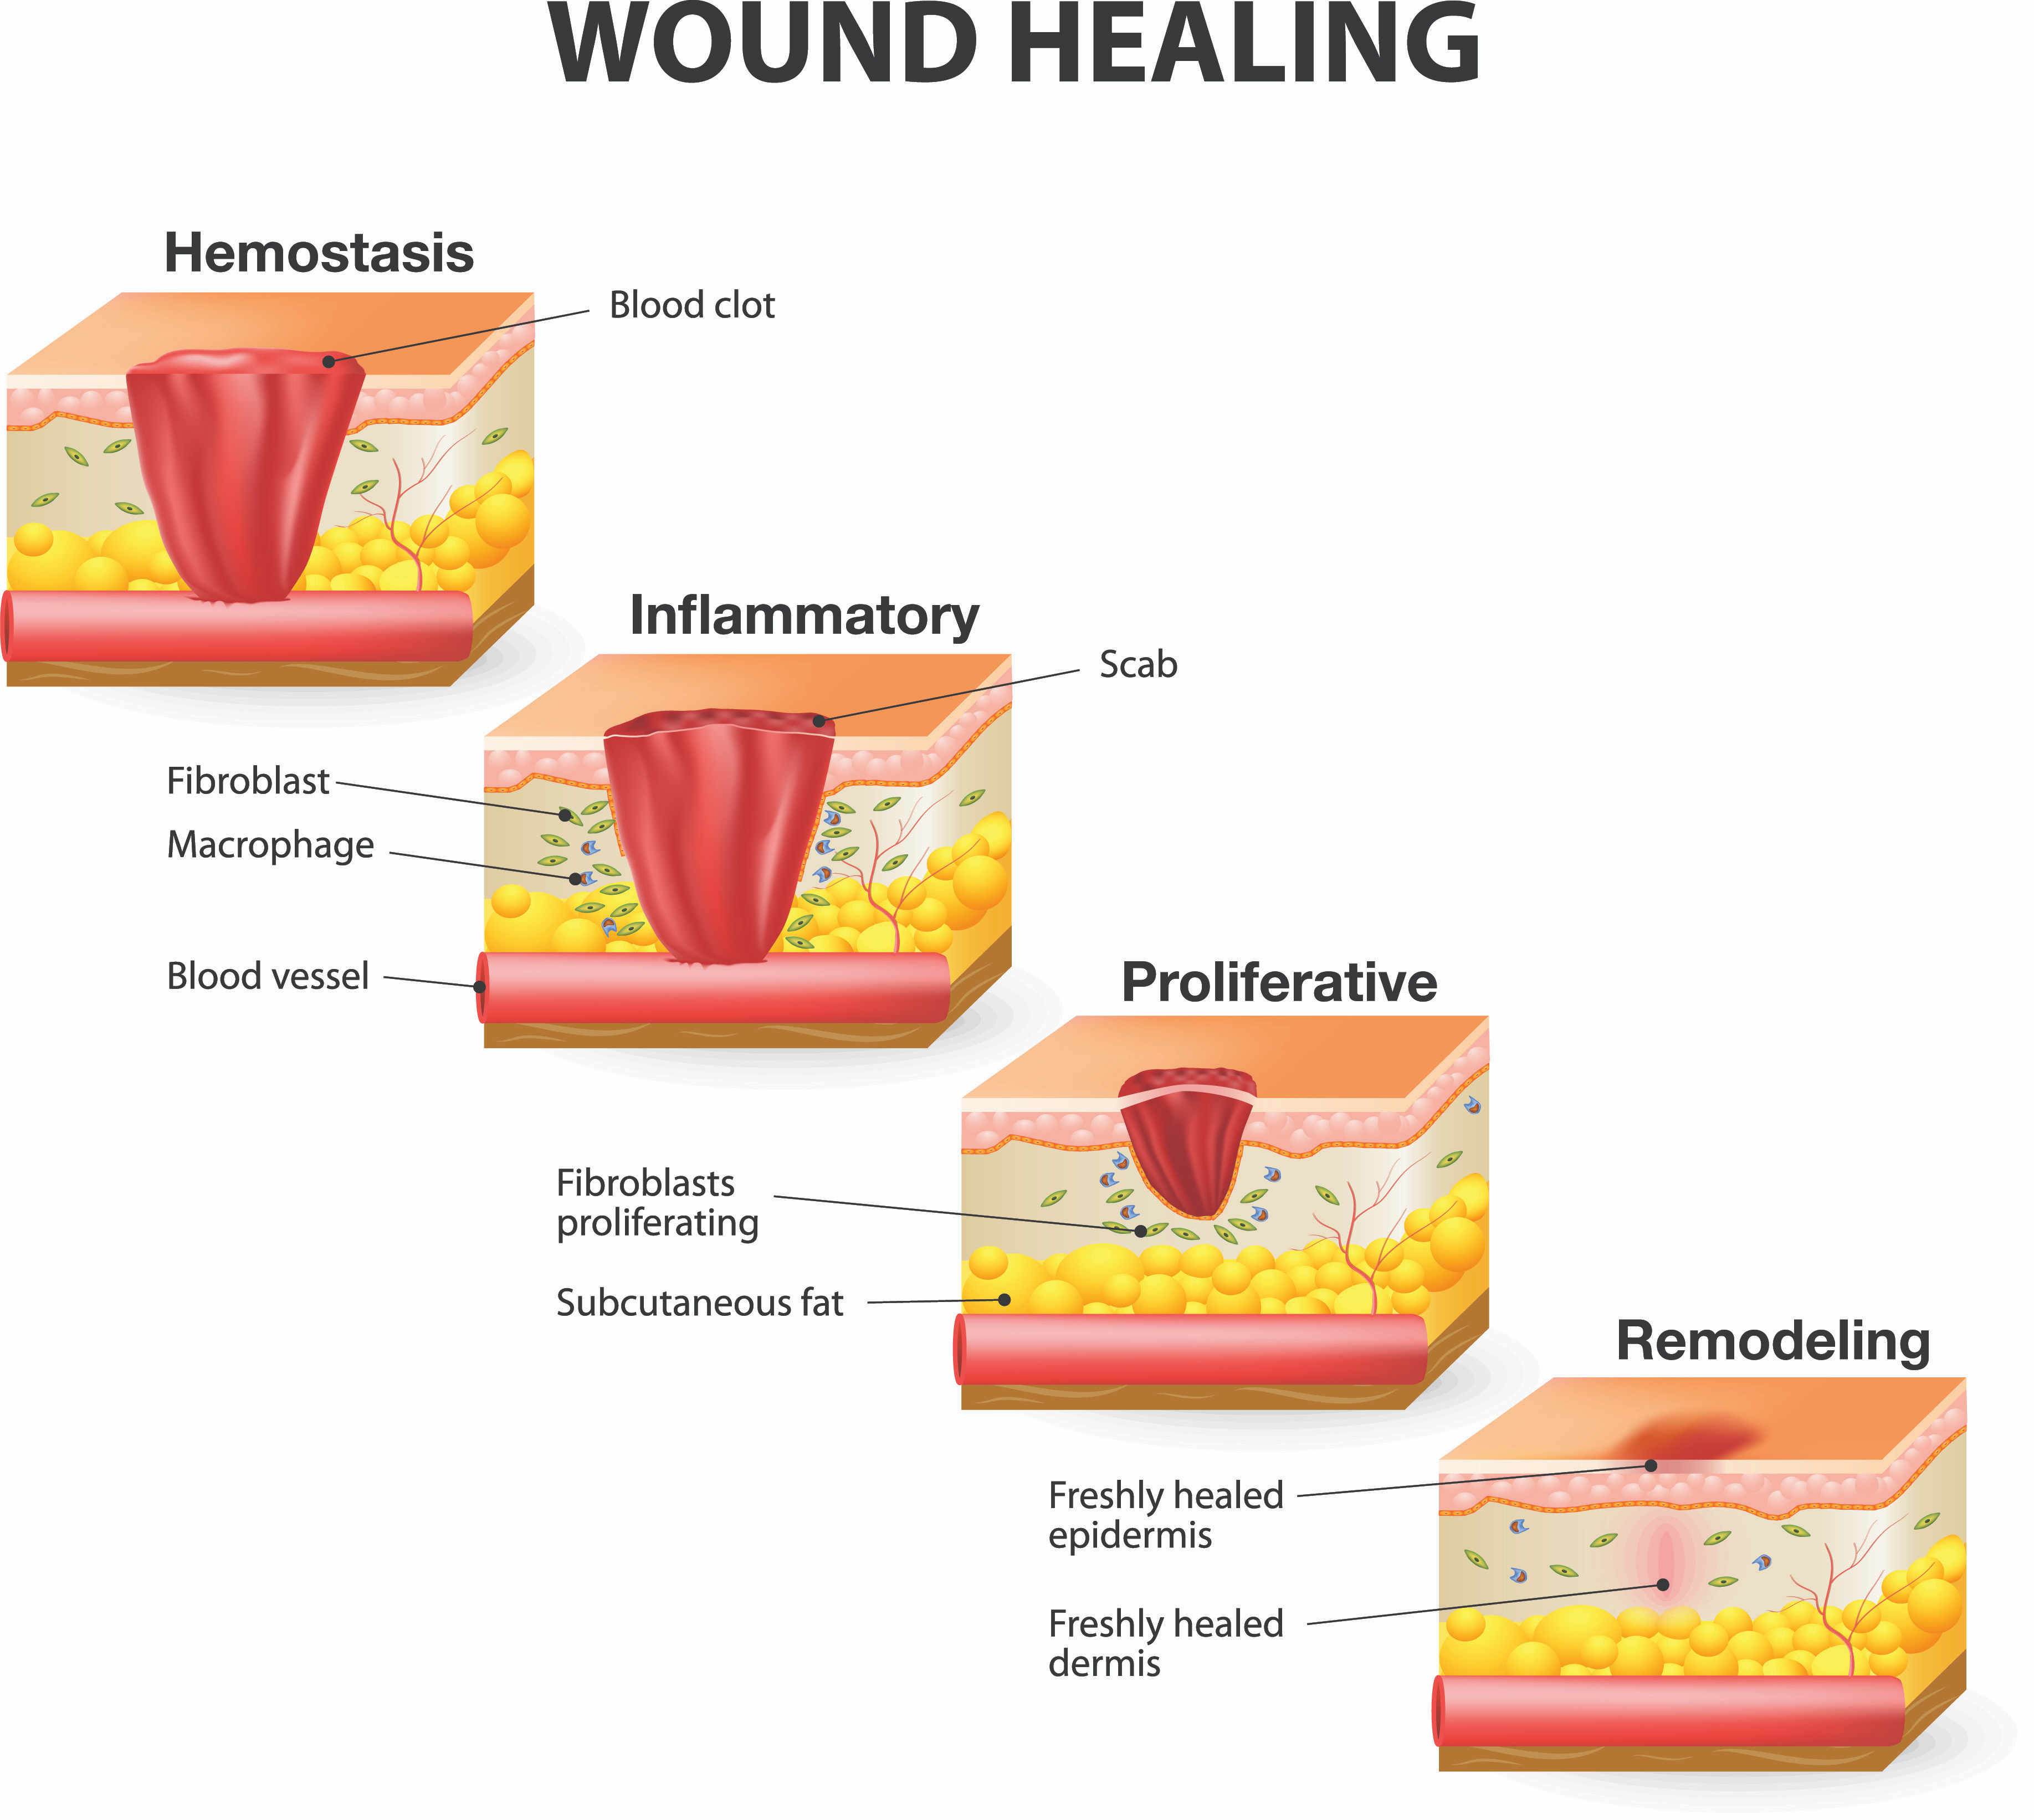
Wounds healing
Wound healing, or wound repair included four phases
1-The Hemostasis.
2- inflammatory.
3- proliferative.
4- remodeling phases.

Slide 32
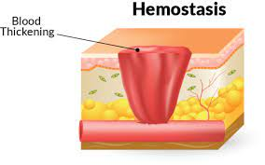
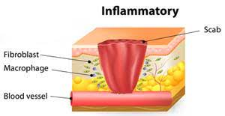
Wounds healing
1- Hemostasis phase:
Hemostasis occurs immediately after the initial injury.
Involved blood vessels constrict and blood clotting begins through platelet activation and clustering
2- The inflammatory phase:
The inflammatory phase follows hemostasis and lasts about 4 to 6 days. White blood cells, predominantly leukocytes and macrophages, move to the wound

Slide 33
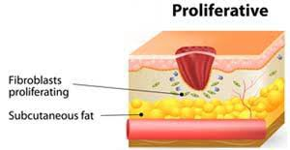
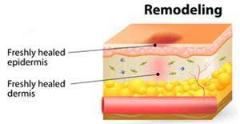
Wounds healing
3- Proliferation phase:
The proliferation phase is also known as the fibroblastic, regenerative, or connective tissue phase, The proliferation phase lasts for several weeks.
4- Maturation phase:
The final stage of healing, maturation (or remodeling) begins about 3 weeks after the injury, possibly continuing for months or years. Collagen that was haphazardly deposited in the wound is remodeled, making the healed wound stronger and more like adjacent tissue.

Slide 34
Definition of skin and functions
A wound is a break in the continuity of a tissue of the body, either internal or external.
Wounds are classified as open or closed.
Types of open Wounds: Abrasions, laceration, incision, puncture, Avulsions.
Wounds Contamination (infection).
Emergency Care for wounds.
Wounds healing :Wound healing, or wound repair included four phases The Hemostasis, inflammatory, proliferative, and remodeling phases.

